Slide 1

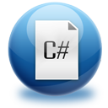


Introduction to Programming
Creating and Running Your First C# Program

Slide 2


Table of Contents
What is Computer Programming?
Your First C# Program
What is .NET Framework?
What is Visual Studio?
What is Microsoft Docs?

Slide 3


What is Computer Programming?

Slide 4

Define: Computer Programming
Computer programming: creating a sequence of instructions to enable the computer to do something
Definition by Google

Slide 5
Programming Phases
Define a task/problem
Plan your solution
Find suitable algorithm to solve it
Find suitable data structures to use
Write code
Fix program error (bugs)
Make your customer happy
= Specification
= Design
= Implementation
= Testing & Debugging
= Deployment

Slide 6

Your First C# Program

Slide 7
First Look at C#
Sample C# program:
using System;
class HelloCSharp
{
static void Main()
{
Console.WriteLine("Hello, C#");
}
}

Slide 8
C# Code – How It Works?
Define a class called "HelloCSharp"
Include the standard namespace "System"
Define the Main() method – the program entry point
using System;
class HelloCSharp
{
static void Main()
{
Console.WriteLine("Hello, C#");
}
}
Print a text on the console by calling the method "WriteLine" of the class "Console"

Slide 9
C# Code Should Be Well Formatted
Class names should use PascalCase and start with a CAPITAL letter.
using System;
class HelloCSharp
{
static void Main()
{
Console.WriteLine("Hello, C#");
}
}
The { symbol should be alone on a new line.
The } symbol should be under the corresponding {.
The block after the { symbol should be indented by a TAB.

Slide 10
Example of Bad Formatting
Such formatting makes the source code unreadable.
using
System
;
class HelloCSharp {
static
void Main( ) { Console . WriteLine ("Hello, C#" ) ;Console.
WriteLine ( "Hello again"
) ;}}

Slide 11

What is "C#"?
Programming language
A syntax that allow to give instructions to the computer
C# features:
New cutting edge language
Extremely powerful
Easy to learn
Easy to read and understand
Object-oriented

Slide 12

What You Need to Program?
Knowledge of a programming language
C#
Task to solve
Development environment, compilers, SDK
Visual Studio, .NET Framework SDK
Set of useful standard classes
Microsoft .NET Framework FCL
Help documentation
MSDN Library

Slide 13


Your First C# Program
Live Demo

Slide 14

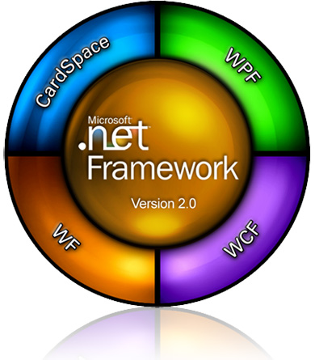

What is .NET Framework?

Slide 15

What is .NET Framework?
Environment for execution of .NET programs
Powerful library of classes
Programming model
Common execution engine for many programming languages
C#
Visual Basic .NET
Managed C++
... and many others

Slide 16
Inside .NET Framework
Building blocks of .NET Framework
C#
C++
VB.NET
J#
F#
JScript
Perl
Delphi
…
ASP.NET
Web Forms, MVC, AJAX
Mobile Internet Toolkit
Windows
Forms
WPF
Silverlight
FCL
WCF and WWF (Communication and Workflow Tier)
ADO.NET, LINQ and XML (Data Tier)
Base Class Library (BCL)
CLR
Common Language Runtime (CLR)
Operating System (OS)

Slide 17
CLR – The Heart of .NET Framework
Common Language Runtime (CLR)
Managed execution environment
Executes .NET applications
Controls the execution process
Automatic memory management (garbage collection)
Programming languages integration
Multiple versions support for assemblies
Integrated type safety and security
CLR

Slide 18
Framework Class Library
Framework Class Library (FCL)
Provides basic functionality to developers:
Console applications
WPF and Silverlight rich-media applications
Windows Forms GUI applications
Web applications (dynamic Web sites)
Web services, communication and workflow
Server & desktop applications
Applications for mobile devices

Slide 19

What is Visual Studio?

Slide 20

Visual Studio
Visual Studio – Integrated Development Environment (IDE)
Development tool that helps us to:
Write code
Design user interface
Compile code
Execute / test / debug applications
Browse the help
Manage project's files

Slide 21
Benefits of Visual Studio
Single tool for:
Writing code in many languages (C#, VB, …)
Using different technologies (Web, WPF, …)
For different platforms (.NET CF, Silverlight, …)
Full integration of most development activities (coding, compiling, testing, debugging, deployment, version control, ...)
Very easy to use!

Slide 22
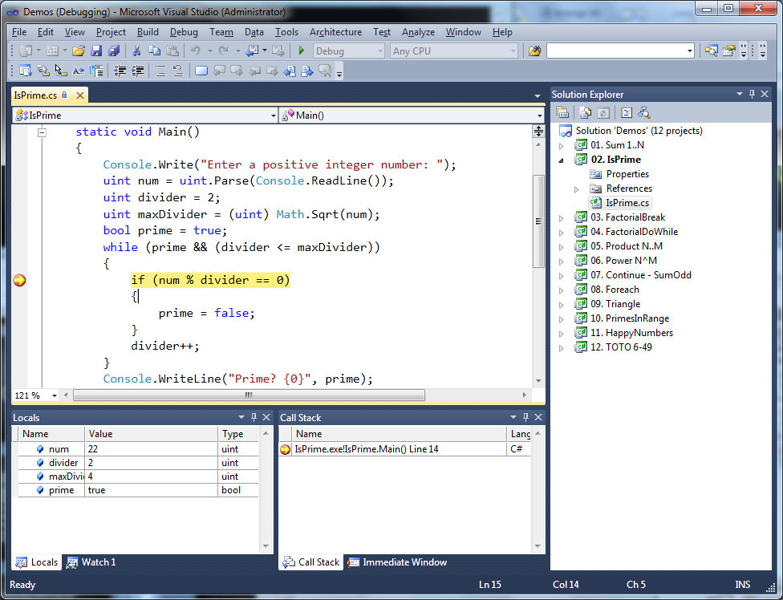
Visual Studio – Example

Slide 23
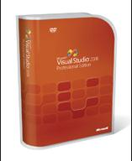

Visual Studio
Compiling, Running and Debugging C# Programs

Slide 24
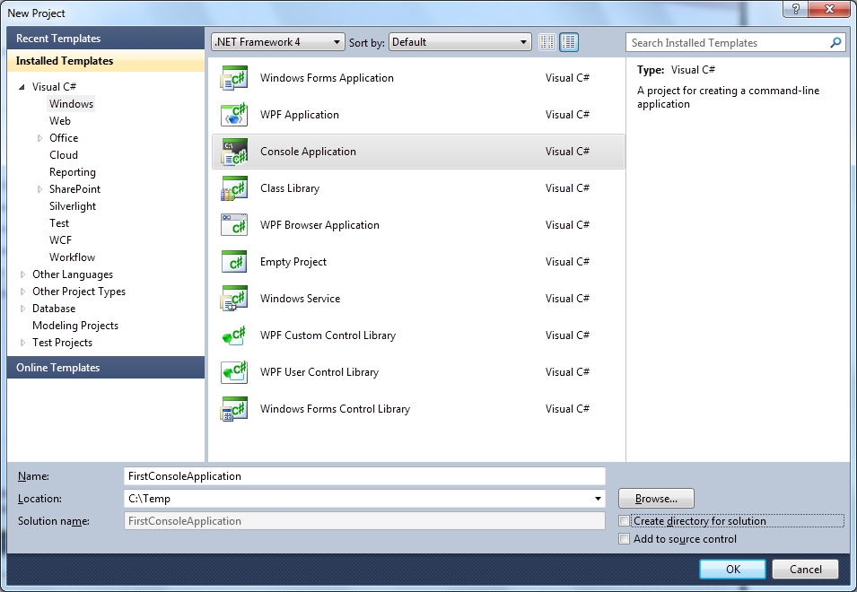
Creating New Console Application
File → New → Project ...
Choose C# console application
Choose project directory and name

Slide 25
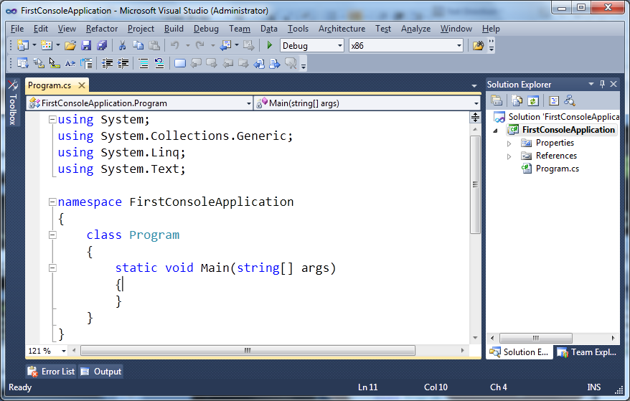
Creating New Console Application (2)
Visual Studio creates some source code for you
Namespace not required
Some imports are not required
Class name should be changed

Slide 26
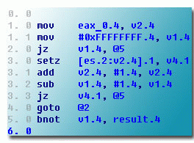
Compiling Source Code
The process of compiling includes:
Syntactic checks
Type safety checks
Translation of the source code to lower level language (MSIL)
Creating of executable files (assemblies)
You can start compilation by
Using Build->Build Solution/Project
Pressing [F6] or [Shift+Ctrl+B]

Slide 27

Running Programs
The process of running application includes:
Compiling (if project not compiled)
Starting the application
You can run application by:
Using Debug->Start menu
By pressing [F5] or [Ctrl+F5]
* NOTE: Not all types of projects are able to be started!

Slide 28



Debugging The Code
The process of debugging application includes:
Spotting an error
Finding the lines of code that cause the error
Fixing the code
Testing to check if the error is gone and no errors are introduced
Iterative and continuous process

Slide 29
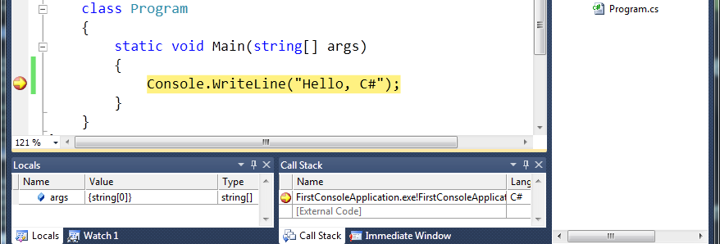
Debugging in Visual Studio
Visual Studio has built-in debugger
It provides:
Breakpoints
Ability to trace the code execution
Ability to inspect variables at runtime

Slide 30

Visual Studio
Compiling, Running and Debugging C# Programs
Live Demo

Slide 31
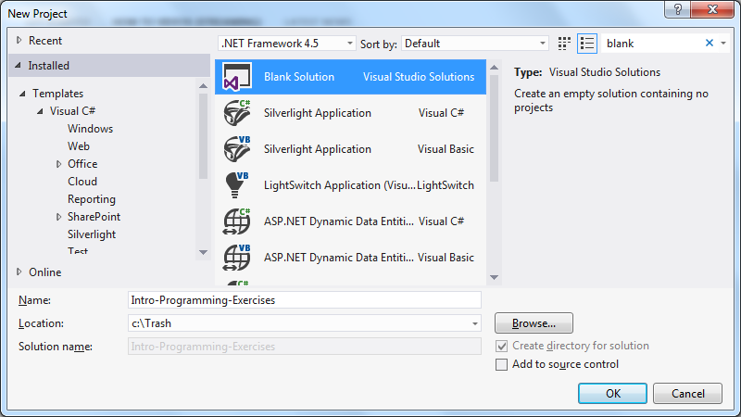

Visual Studio Blank Solution
Creating a Solution Without Projects

Slide 32
What Is a Blank Solution?
A Visual Studio blank solution
Solution with no projects in it
Projects to be added later
What is the point?
Not making a project just to give proper name
And not working in this project

Slide 33
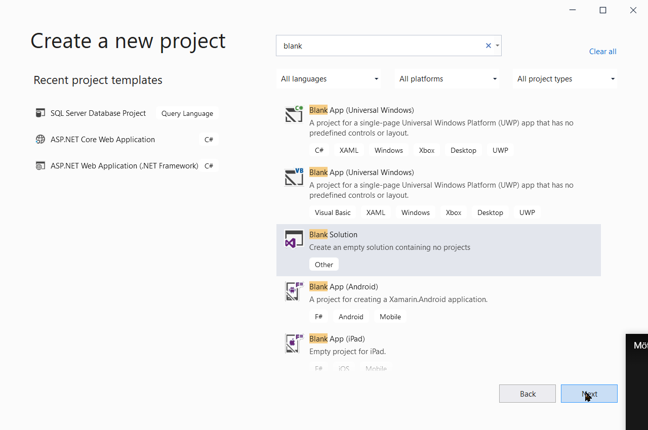
VS Blank Solution

Slide 34

Visual Studio Blank Solution
Live Demo

Slide 35

What is Microsoft Docs?

Slide 36
What is Microsoft Docs?
Complete documentation of all classes and their functionality
With descriptions of all methods, properties, events, etc.
With code examples
Related articles
Library of samples
Found at https://docs.microsoft.com/sv-se/
Or at https://docs.microsoft.com/en-us/

Slide 37
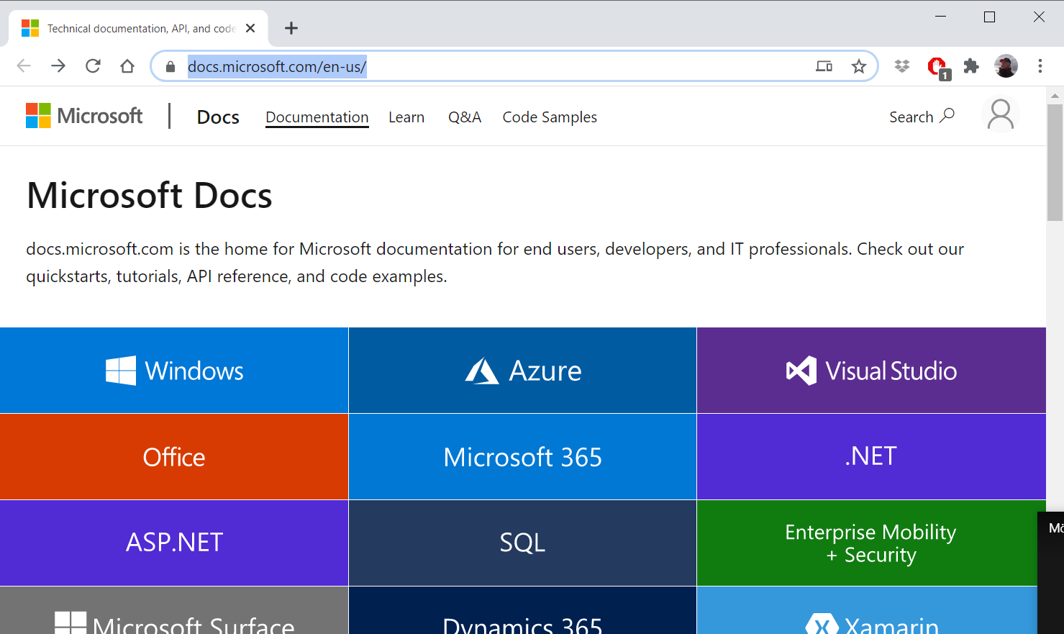
Microsoft Docs

Slide 38
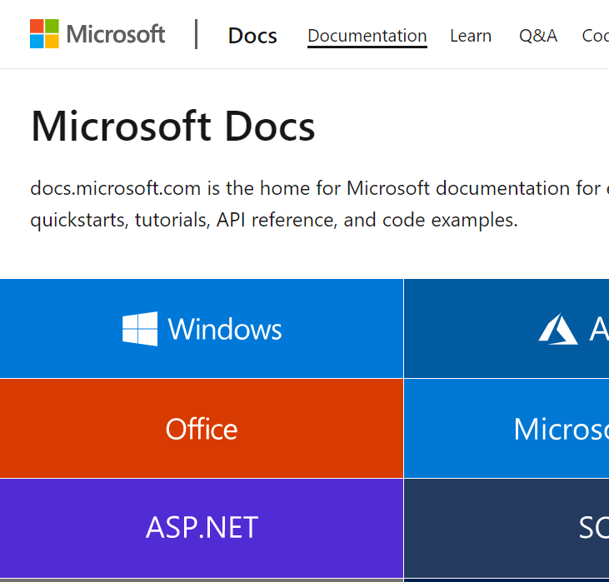

Microsoft Docs
Browsing and Searching Documentation
Live Demo

Slide 39



Introduction to Programming
Questions?
http://academy.telerik.com

Slide 40
Exercises
Familiarize yourself with:
Microsoft Visual Studio
Microsoft Developer Network (MSDN) Library Documentation
Find information about Console.WriteLine() method.
Create, compile and run a “Hello C#” console application.
Modify the application to print your name.
Write a program to print the numbers 1, 101 and 1001.

Slide 41
Exercises (2)
Install at home:
Microsoft Visual Studio (or Visual Studio Express)
Create console application that prints your first and last name.
Create a console application that prints the current date and time.
Create a console application that calculates and prints the square of the number 12345.
Write a program that prints the first 10 members of the sequence: 2, -3, 4, -5, 6, -7, ...

Slide 42
Exercises (3)
Provide a short list with information about the most popular programming languages. How do they differ from C#?
Describe the difference between C# and .NET Framework.
* Write a program to read your age from the console and print how old you will be after 10 years.
* NOTE: If you have any difficulties, search in Google.

